Slide 1
Reviewing Game Design
Luke Bruni

Slide 2
Section 1- Understanding Games Design
What Games Design is

Slide 3
What is Game Design
Game Design can take many different meanings over the course of the existence of video games. From the many elements of game design, be it the story, characters, levels etc. it is generally known as the idea behind a game.
However, when accurately trying to define game design, you have to take note of many elements and the type of game being developed. Larger, more in-depth games, the game design takes focus on elements such as its theme, plot, characters with their backstories, more narrative aspects. Smaller games or otherwise simply refer to how to play the game, it’s rules, scoring and difficulty^{[1]}.
This can create different aspects to video game design where it goes beyond an idea. Games Design is diverse and can range with different roles.
Level Designer
Writer/Storyline
Artist/Content Designer
Programmer
World Designer
Interface Designer^{[2]}

Slide 4
What is needed?
There are the fundamentals of requirements that will be needed when going into a career in games design.
Education requires someone considering games design to have either a degree, HND or otherwise in either a games related course or something relating to computer science or other similar education.
Experience is needed to get into games design, with knowledge or a portfolio^{[3]}.
Notes:
It’s required to understand what would be important in being a games designer. Important elements to take note would be, in what part of games design would you want to be a part of, as designing games takes in more than one role and games are developed with high emphasis on team building.
Before that a game designer can get into the industry properly, they have to build up a good background in games design. First, is education. Many people would get a degree within computer science or programming, however, as games design courses are becoming more prominent, it is much useful to get a degree, HND or otherwise within these courses. If you were to go on a games design course, it would be imperative that you would go on such a course for the experience and not to prove that you have a degree in the subject.
The next part of what a person would need to pursue such a career would be the knowledge, experience and a nice portfolio. This is essential in terms of actually getting a foot in the door of game design role, to which as such even getting a degree in some companies wouldn’t cut it and would rather see the skills that the person has acquired through any means, even as a hobby. This could be anything as from an animation demo, evidence of programming, 3D modelling or even an entire game being developed and released^{[3]}.

Slide 5
Elements of Game Design
Challenge – The key objective or the actions that would contribute to achieving the goal.
Choice – Choosing how to play the game or advance through the game
Change – Different elements that would alter the dynamic of the game and keep it fresh
Chance – Defines how the game is played, with plans for each part of the game
Notes:
When it comes to designing a game, there are a choice of elements that would make up a game. These elements would help create an idea of the game.
Challenge is the key element of a game, where the challenge defines what the player should do or how they should act. Though they can be a goal or objective, every part of game that a player would play would result in a challenge; winning a race in game just to progress further or even jumping over an obstacle.
Choice basically can add to the narrative or experience of a game. The choices can vary between just selecting characters, classes, weapons or cars that could alter the game in a way to the player. But also in terms of gameplay, such as quick second decisions and would ultimately result in different outcomes to the game^{[20]}.
Change is also a factor in games design, where it alter the objective of a game. If elements stayed the same throughout the game, the player would quickly get bored. This element can make for challenging and intense gameplay, anything from different levels to that of achievements, even a change midgame when the player would least expect it would offer intense gameplay.
Chance is the final element of games design. This defines how a game is played and the steps needed to take on that journey to the objective, such as how to defeat a certain enemy or how much fuel to take to a race. This can define skill within players and can add dynamic elements to a game, making it even more challenging^{[21]}.

Slide 6
Section 2 - TimeLine
1960s – 2010s

Slide 7
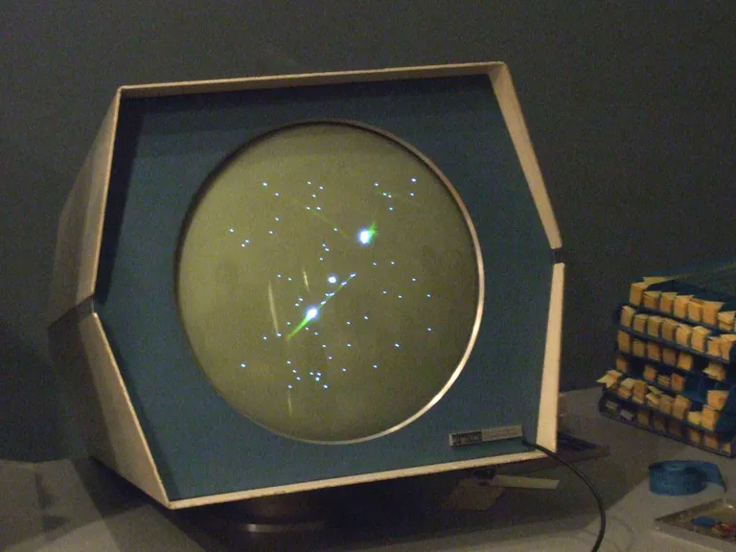
1960s
SPACEWAR!
Developed in 1962
Created by Steve Russel
Developed on a minicomputer using a CAT display and keyboard
Has two player fly and attack each other with weapons while avoiding the sun.
Elements of the game would be influential to later game developers and games. For example, Asteroids
Notes:
Spacewar! was developed in 1962 by a computer programmer, Steve Russell.
The game was developed on an early minicomputer, known as a PDP-1, using a cathode-ray tube display and a keyboard.
The game was a two-player game, where both players flew spaceships, firing missiles at each player whilst avoiding the gravitational pull of the sun[4]. It also allowed for real-time action, different game conditions, a variety of weapons and a physics system.
The game was influential to later developers, with many conventions that would be used today. Asteroids in 1979 took influence of the game, with similar elements within its gameplay[5].

Slide 8
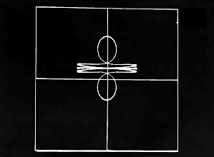
1960s
Space Travel
Developed in 1969
Created on an outdated minicomputer at the time.
Simulated the solar system and allowed the player to explore it in a spaceship
Considered the first UNIX application and brought about the UNIX operating system.
Notes:
Space Travel was a game developed in 1969, on an obsolete computer system known as the PDP-7 at Bell Labs.
The game simulated the travel of solar systems to scale on a 2-D plane. The player controlled a pilot, which can fly around the solar system, land on various planets and moons and can observe the scenery. Other features that contributed to the simulation was the fact that the solar system can move and the gravity varies based on the strongest attractor to the ship, which can also make for difficult landings.
The game was considered the first ever UNIX application, which led to the development of the UNIX operating system, making more of an impact on the computer industry rather than the game industry^{[6][7]}.

Slide 9
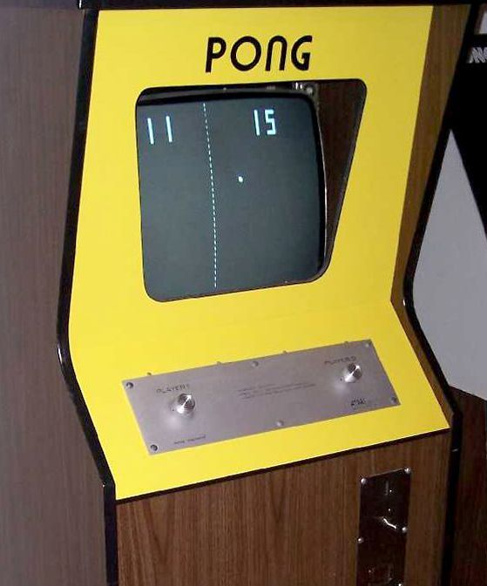
1970s
Pong
Created in 1972
Developed by Atari
Simplistic game consisting of two paddles batting a ball back and forth.
A commercial success that led to Atari expanding its company, producing more products and more games and home consoles to be produced.
Notes:
Pong was developed in 1972, developed by Nolan Bushnell and Ted Dabney over at Atari. The game was developed for two-player gameplay, with two analogue knobs to control the paddles.
The game was simplistic, with the only aim being that two players hit a ball back and forth, with the first player being the first to score the maximum amount of points. The player can even choose to play against a computer controlled AI.
The interface was generic, being only simplistic looking graphics due to the technical abilities at the time. The game only rendered rectangular paddles and a square ball that could bounce on the sides of the screen.
The game was the first commercially successful game, earning more revenue than other coin operated machines at the time and led to Atari developing more systems and expanding, and many iterations of Pong consoles for playing at home. Other developers jumped on the bandwagon of pong and home consoles, such a Magnavox and Nintendo^{[8]}.

Slide 10
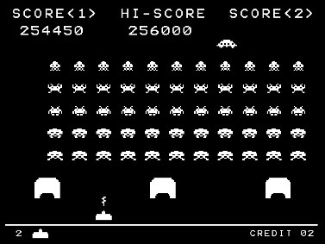
1970s
Space Invaders
Developed in 1978 by Japanese company, Taito
A simple game that seen the player fighting off countless waves of alien invaders until they were out of lives.
A worldwide success that allowed for more space shooters and shooters in general, expanded the Japanese arcade market and contributed to the growth of home gaming.
Notes:
Space Invaders was created in 1978 by Japanese company, Taito. The game was released in numerous arcades and is seen as the pioneer of modern gaming.
The gameplay of Space Invaders made for a simple, but a slowly intense game. The player controls a spaceship to battle columns of alien invaders and a UFO that passes over the top, each having their own score once the player shoots them. The speed of the invaders increase each time as the players clear them off one by one and if the player lets them hit the ground, then its game over.
The game proved to be a worldwide success and had greatly affected the popularity of gaming as a whole. It paved the way for more similar space shooters and other shooter games that also took hold, the Japanese arcade market had boomed with more coin operated arcade games starting to pop up as time went on and thanks to a port on the Atari 2600, it raised the popularity of home gaming^{[9]}.

Slide 11
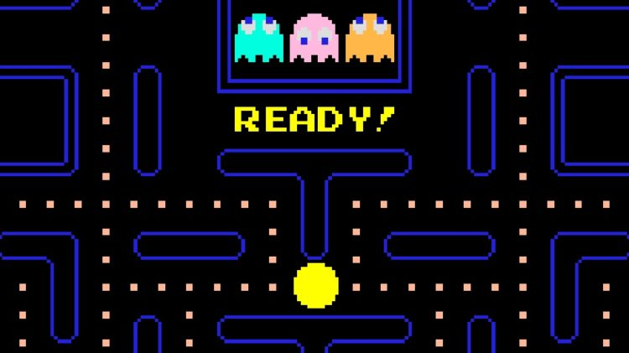
1980s
Pac-Man
Created in 1980
Developed by Namco, lead by Tohru Iwatani
Game revolves around you eating up dots around the maze while avoiding ghosts
Iwatani carefully designed the game to not be centred around violence
The ghosts had their own behaviours
Pac-Man became a mainstay in pop culture
Notes:
Created in 1980 by Japanese arcade game manufacturer Namco, with the lead designer being Tohru Iwatani.
The game centred around a small little ball, known as Pac-Man, trying to manoeuvre through a maze and to eat up all of the coloured dots until the maze was clear, while trying to avoid the ghosts that populated the maze. Pac-Man would eat a Power Pellet in order to eat up the ghosts, buying the player more time.
When Iwatani developed Pac-man, his aim was to make a game that wasn’t centred around violence, such as the games before it, such as Space Invaders. He wanted to create a game that would appeal also to females, so careful consideration was put into the game’s design, theme and colour palette. Instead of shooting aliens, the game had a high emphasis on eating^{[10]}.
A special feature about the game was the AI, where the ghosts wouldn’t just follow Pac-man around the maze, but would take different steps in trying to capture them. This movement was a personality trait of each ghost. Blinky, the red ghost, would chase Pac-man directly; Pinky, the pink ghost, would ambush Pac-man; Inky, the blue ghost, is unpredictable in terms of catching Pac-Man; and Clyde, the orange ghost, is just random^{[11]}.
Pac-Man’s innovative design made for it to be very popular on pop culture than any other game at the time and as such, Pac-Man got songs based on him, merchandise, a cartoon television series and other imitations^{[10]}.

Slide 12
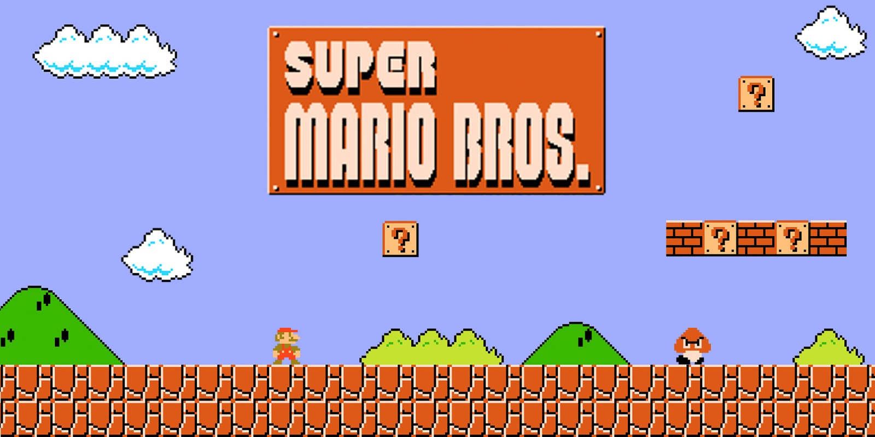
1980s
Super Mario Bros.
Created in 1985
Developed by Nintendo for the Nintendo Entertainment System (NES)
Has the player control Mario around numerous levels to defeat the evil king Bowser and save a princess
Became a resounding success, launching Nintendo’s mascot and a famous game franchise
Notes:
Super Mario Bros. was developed in 1985 by Nintendo and was a sequel to the arcade game Mario Bros. The game was developed for the Famicom console over in Japan and then for the Nintendo Entertainment System.
The game features two Italian plumbers, called Mario and Luigi, going through a multitude of levels to save a princess from an evil king called Bowser. Each level consists of many side scrolling levels with many enemies and different settings; under the sea, dungeons and even in the sky. Each level zone, ends with a battle between bowser and Mario, only to find that the princess is in another castle.
The game became a huge success and its popularity was boosted insignificantly with more games in the series, a cartoon show and a live action film, but most importantly, it launched Nintendo’s mascot and most popular gaming franchise^{[12]}.

Slide 13
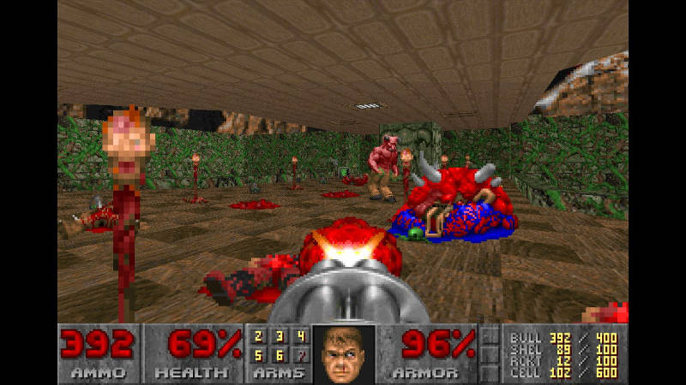
1990s
Doom
Created in 1993
Developed by ID Software
A first person shooter that seen the player gunning down demons in a Mars space station
Known for its fark atmosphere and gory violence.
Improved on the elements of Wolfenstein 3D
Boosted the popularity of first person shooters as well as started the multiplayer shooter trend
Notes:
Doom was developed in 1993 was a first person shooter in the vain of Wolfenstein 3D. It was developed by ID Software for various home computers.
The game was a sci-fi, horror mix that saw the player controlling an unidentified marine, sent on a mission onto a mars space station and eliminate a hellish threat. Players have to kill demons in any way possible, be it by punching, shooting or even using a chainsaw.
The design improved on that of Wolfenstein 3D, resulting in an improved 3D model, better graphics and even peer-to-peer multiplayer gaming^{[13]}.
The game was known infamously for its amount of violence, from the level of blood and slaughtering of demons, alongside its dark, moody aesthetic and audio. But most notably, it led to it being part of an investigation of a school shooting in 1999, leading families to sue the creators, but the case was thrown out^{[14]}.
Though, despite the controversy, Doom was a success, heightening the popularity of PC gaming at the time and popularized first-person shooters, despite them being called “Doom clones” around this time. The multiplayer mode in Doom, contributed to the popularity of multiplayer games to come, such as Quake^{[13]}.

Slide 14
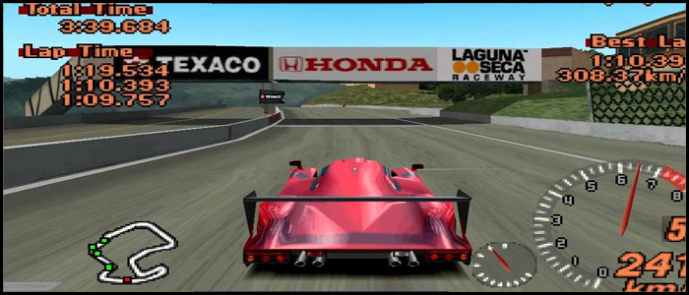
1990s
Gran Turismo 2
Created in 1999
Developed by Polyphony Digital
Like its predecessor, it is a racing game based on real life motorsport
The game is designed in such a way to simulate actual car handling and include other realistic features such as tracks and cars.
The game included rally segments with true to life rally cars.
Notes:
Gran Turismo 2 was developed in 1999 by Polyphony Digital and was seen as “The Real Driving Simulator”. It was developed for the PlayStation console.
The game was heavily influenced in motorsport, as was its predecessor, Gran Turismo. Players can either do quick races in Arcade mode or play a career based mode called “Gran Turismo Mode”, where you can buy cars, race in different leagues, upgrade and maintain the cars and complete license tests in order to unlock more professional leagues.
The game was known for its level of realism; from the handling of the cars, the race tracks, car manufactures and the intense races. Special races included endurance racing and car based championships^{[15]}.
Stepping up from Gran Turismo, the second game included rally events; off road racing on dirt courses with rally cars and other features such as a wheel customizer and authentic car audio.

Slide 15
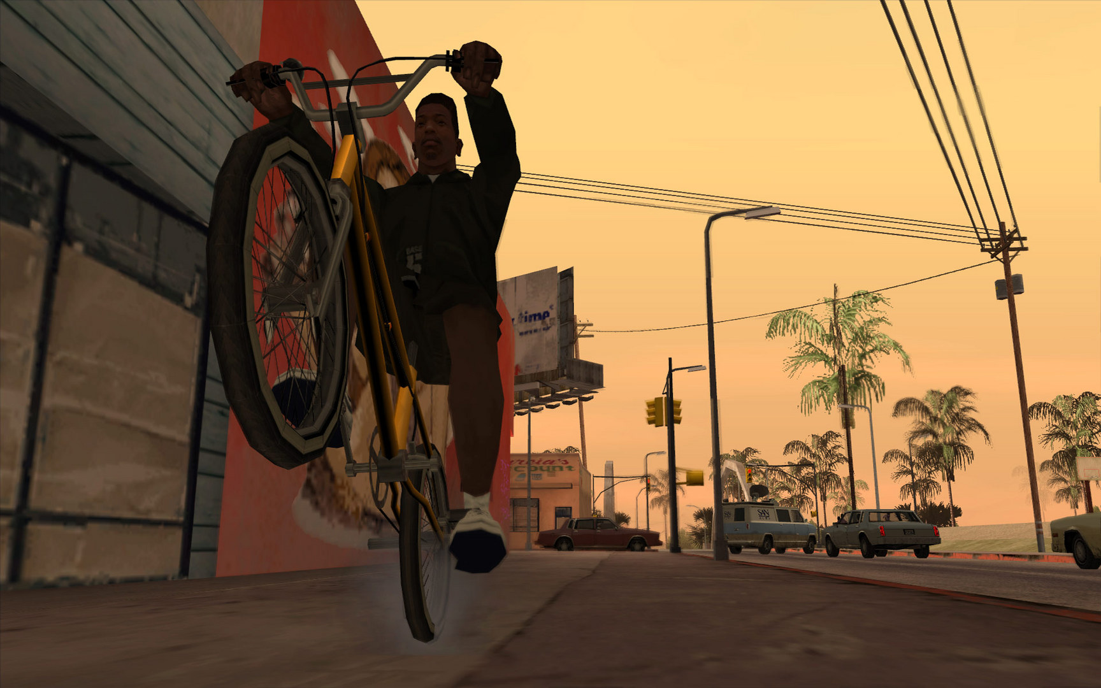
2000s
Grand Theft Auto: San Andreas
Created in 2005
Developed by Rockstar Games
Open world gameplay, along with numerous game features that added to the technical gameplay
Controversial mode left in the game’s files almost led to a strict rating
Achieved as the most innovative titles of the series
Notes:
Grand Theft Auto: San Andreas was developed in 2005 by Rockstar Games. The game was developed for the PS2, Xbox and PC, but now currently can be found on newer consoles and mobiles.
The gameplay is the same from the previous entries, third-person shooting and driving, where the player can navigate the character around a massive environment and can utilise any vehicle in the game world. The game has a variety of features, more than the previous entries as the player can now swim and customize their character, along with different stats that will show the player’s skills that can be affected by different actions.
This game has gang territory, where the player can win by battling with gangs and can organize a gang themselves.
Controversy arose over a game mode that brought about taboo content, leading almost to the game getting a higher rating in America. This caused a change within the game’s second version where the content was removed.
The game was marvelled for its technical achievements that weren’t seen in many games at the time and garnered several rewards, further proving the series’ innovative gameplay^{[16]}.

Slide 16
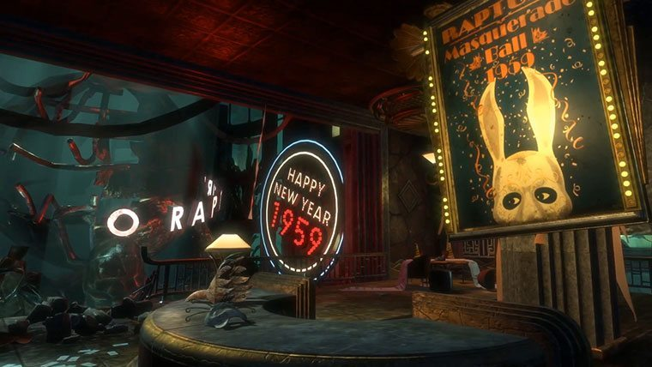
2000s
Bioshock
Created in 2007
Developed by Irrational Games
First person shooter with role playing elements and emphasis on survival
Players can genetically modify themselves and upgrade their weapons
The design of the world incorporates a luxurious art deco feel and lively utopia amidst a ravaged, fallen and claustrophobic city.
Notes:
Bioshock is a game developed by Irrational Games in 2007 for Xbox 360, PS3 and PC.
The game takes place in an underwater city, built to escape the problems of the world above, but collapsed due to a civil war. The player takes control of a character would landed in the city following a plane crash and has to try to escape. The game is a first person, story based shooter with emphasis on survival; the player has to use everything to their advantage, such as the environment, weapons, and body enhancements. Upgrading elements is a key feature of the game, where the character can upgrade their stats and weapons. Plasmids are a feature were the character can genetically enhance themselves to enable powers to use against the enemies^{[17]}.
The design of rapture is seen as a unique world, creating a memorable atmosphere that the player won’t forget. The city atmosphere is trapped in an art deco past while being ravaged by the inhabitants when the city collapsed, the facades of the city looking over one another add to the claustrophobia that the city brings, but also sections of pure beauty that the city adds^{[18]}.

Slide 17
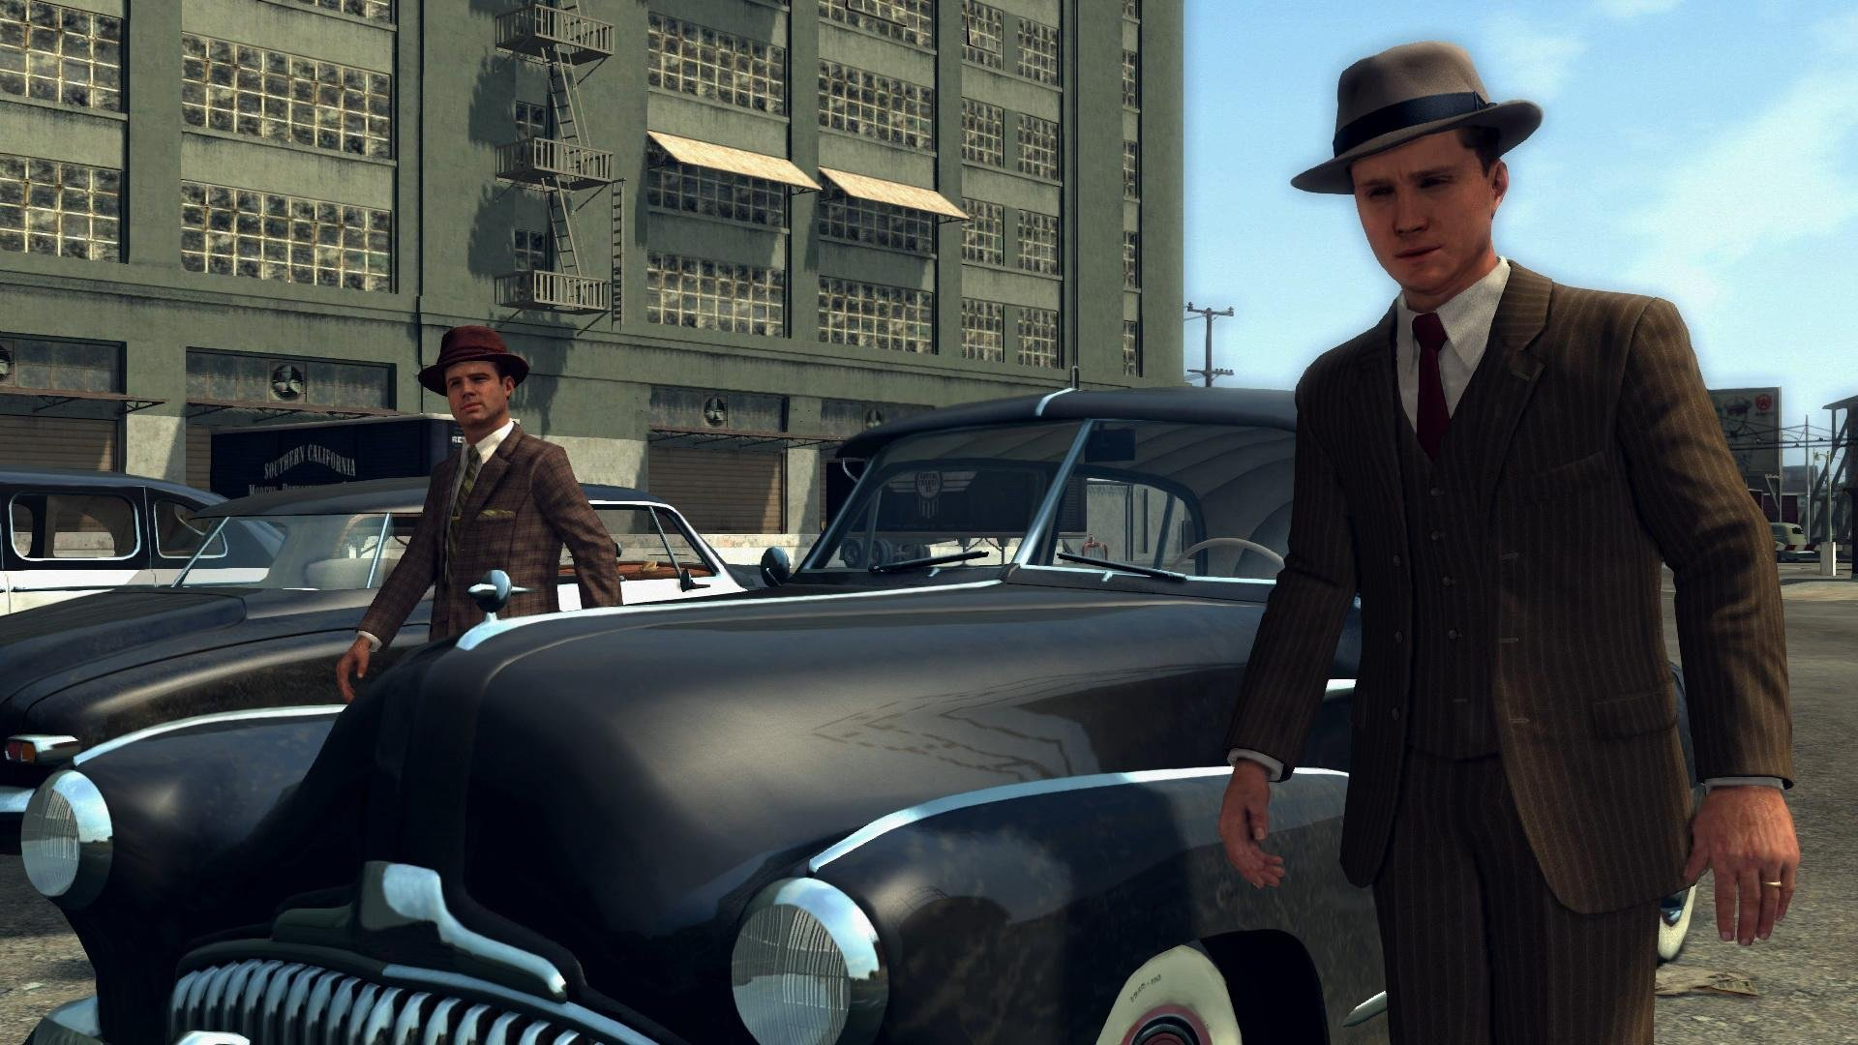
2010s
L.A. Noire
Created in 2011
Developed by Rockstar Games and Team Bondi
Set in 40s Hollywood with the player solving murder cases by investigating the crime scenes and interrogating any key people
Authenticity played a huge part and special facial recognition was used to achieve it in certain parts of the game
Notes:
L.A. Noire was a game developed in 2011 by Rockstar Games and Team Bondi, originally made for the Xbox 360, PS3 and PC.
The game takes place in the late 1940s in Hollywood, where the player controls a detective in various cases. The main elements of the game come from the interrogations and investigations, as well as trying to capture the suspect. The interrogations would have the player determine if the character they were investigating was telling the truth, exaggerating facts or lying about something. Investigations were a key aspect as well, as finding clues would be beneficial to the interrogations of the game and would affect the outcome of the case.
Special technology was used at the time to accurately capture the movement of the actors faces and use them in game. This was used to help with the interrogation scenes, as they would’ve been portrayed to add authenticity, and to make more of a cinematic, believable look to the game.
The game was a success and led to a remastered version for the Xbox One and PS4 in 2017^{[19]}.

Slide 18
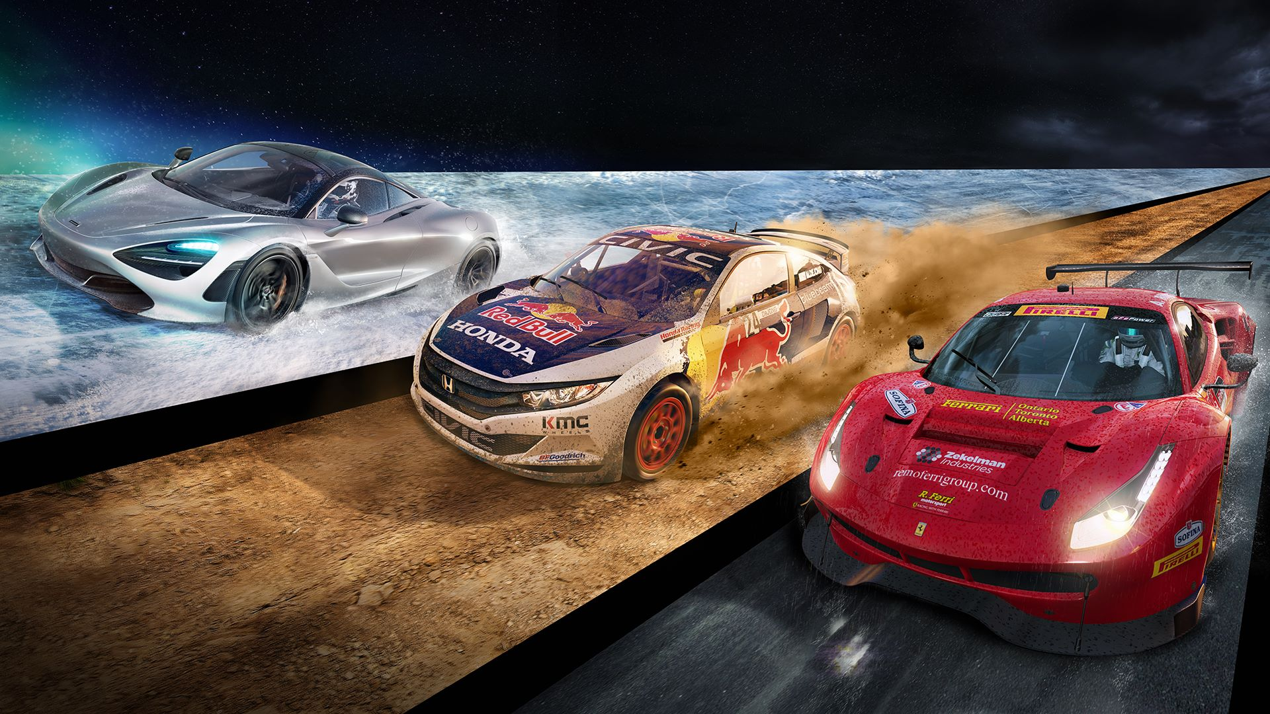
2010s
Project Cars 2
Created in 2017
Developed by Slightly Mad Studios
Has the player race in different leagues and divisions
Game emphasises the simulation aspect of the game with an authentic handling model that can be affected by the game’s environments.
The game has unique models that also impact the dynamics of the game and adds realism
Notes:
Project Cars 2 was developed by Slightly Mad Studios in 2017 for Xbox One, PS4 and PC. The game is a racing simulator that aims to replicate motorsports racing.
The game aims to recreate the feel of actual championship racing. The player can choose to race in actual environments and in actual racing divisions, such as GT racing and LMP.
The physics in Project Cars 2 are essential as they replicate authentic handling of the cars and have an affect on the control of the cars in various environments. The game now allows rally racing and snow can be a part of the races, adding to more weather and environment changes which make it more of a challenge to drive.
Different models in the game add to the authenticity; a dynamic tire simulation which can be affected via elements of a race such as track temperature. This along with more innovative features adds to the simulation aspect of the game.

Slide 19
Section 3 - Conclusion
The True definition of game design

Slide 20
Conclusion
Game Design is based on what the designer can do
The games elements come from the different aspects of design
A definition would be based on the game designers idea of the game, based on what that game was
Notes:
The true definition of games design can only be fathomed by what the designers of a game can do. It can be anything simple such as just designing a game for a simple purpose, but in terms of the requirements, the skills or the company, game design has many meanings, be it to design a game for proving a concept or in the sense of the designer, it could be to go above and beyond in order to create something more ambitious which could make massive acclaim or even prove revolutionary.
Designs makes a game a game and even with the technical limitations of then or now, it won’t stop from delivering something that could prove that game to be worth playing. In terms of art design, the look of the game can reflect on what the game is about and what to expect, level design would showcase what the world would be and how the player interacts with it. Many different elements can make up an entire game based on its design.
Overall, there is no true meaning, but games design is based on what the designers can offer in terms of delivering to the players, which can vary from game to game and from what would go into the actual game.

Slide 21
References I
Jill Duffy (2007). Game Design, An Introduction. [online]. Game Career Guide. Available from: <http://www.gamecareerguide.com/features/411/game_design_an_introduction.php>. [Accessed 3 December 2018].
International Student [online]. (n.d). Available from: <https://www.internationalstudent.com/study-game-design/what-is-game-design/>. [Accessed 3 December 2018].
Game Designing [online]. (2018). Available from: <https://www.gamedesigning.org/learn/requirements/>. [Accessed 20 December 2018].
Mary Bellis (2017). The History of Spacewar. [online]. Thought Co.. Available from: <https://www.thoughtco.com/history-of-spacewar-1992412>. [Accessed 20 December 2018].
Matt Barton, Bill Loguidice (2009). The History of Spacewar!: The Best Waste of Time in the History of the Universe. [online]. Gamasutra. Available from: <http://www.gamasutra.com/view/feature/4047/the_history_of_spacewar_the_best_.php?print=1>. [Accessed 20 December 2018].
Ultimate History of Video Games [online]. (2014). Available from: <https://ultimatehistoryvideogames.jimdo.com/space-travel/>. [Accessed 20 December 2018].
Ken Thompson: A Brief Introduction [online]. (2007). Available from: <http://www.linfo.org/thompson.html>. [Accessed 20 December 2018].
Computing History [online]. (2009). Available from: <http://www.computinghistory.org.uk/det/4007/Atari-PONG/>. [Accessed 20 December 2018].
The Editors of Encyclopaedia Britannica (2015). Space Invaders. [online]. Encyclopaedia Britannica. Available from: <https://www.britannica.com/topic/Space-Invaders>. [Accessed 20 December 2018].
Henry E. Lowood (2004). Pac-Man. [online]. Encyclopedia Britannica. Available from: <https://www.britannica.com/topic/Pac-Man-1688279>. [Accessed 21 December 2018].

Slide 22
References II
Chad Birch (2010). Understanding Pac-Man Ghost Behavior. [online]. Game Internals. Available from: <http://gameinternals.com/post/2072558330/understanding-pac-man-ghost-behavior>. [Accessed 21 December 2018].
William L. Hosch (2008). Super Mario Bros. [online]. Encyclopaedia Britannica. Available from: <https://www.britannica.com/topic/Super-Mario-Bros>. [Accessed 21 December 2018].
Henry E. Lowood (2008). Doom. [online]. Encyclopaedia Britannica. Available from: <https://www.britannica.com/topic/Doom>. [Accessed 21 December 2018].
BBC (2001). Columbine families sue computer game makers. [online]. BBC News. Available from: <http://news.bbc.co.uk/1/hi/sci/tech/1295920.stm>. [Accessed 21 December 2018].
Sony Computer Entertainment Europe (2001). Gran Turismo 2 [online]. Available from: <http://www.granturismo2.com/>. [Accessed 21 December 2018].
GTA Wiki [online]. (n.d). Available from: <https://gta.fandom.com/wiki/Grand_Theft_Auto:_San_Andreas>. [Accessed 21 December 2018].
Bioshock Wiki [online]. (n.d). Available from: <https://bioshock.fandom.com/wiki/BioShock>. [Accessed 21 December 2018].
Rob Dwiar (2017). The genius of Rapture. [online]. Eurogamer. Available from: <https://www.eurogamer.net/articles/2017-08-21-the-genius-of-rapture>. [Accessed 21 December 2018].
Scott Meslow (2017). Revisiting L.A. Noire, the Game That Nearly Revolutionized the Video Game Industry. [online]. GQ. Available from: <https://www.gq.com/story/revisiting-la-noire>. [Accessed 21 December 2018].

Slide 23
References III
Darran Jamieson (2017). The Four Elements of Game Design: Part 1. [online]. EnvatoTuts. Available from: <https://gamedevelopment.tutsplus.com/articles/four-elements-of-game-design-1--cms-22720>. [Accessed 21 December 2018].
Darran Jamieson (2017). The Four Elements of Game Design: Part 2. [online]. EnvatoTuts. Available from: <https://gamedevelopment.tutsplus.com/articles/four-elements-of-game-design-1--cms-22720>. [Accessed 21 December 2018].

